Slide 1
ACTIVE HUNTING Using ELK
By: Ashutosh Bhave

Slide 2
Introduction

Slide 3
Active Hunting
Active hunting is a methodology used by an organization’s information security team to detect and track down any malicious activity occurring within their internal network by monitoring the network logs for anamalous behavior .

Slide 4
ElasticSearch
ElasticSearch is a search server based on Lucene. It provides a distributed, multitenant-capable full-text search engine with an HTTP web interface and schema-free JSON documents. Elasticsearch is developed in Java and is released as open source under the terms of the Apache License.

Slide 5
Logstash is an open source tool for collecting, parsing, and storing logs for future use.
Kibana 3 (or latter versions) is a web interface that can be used to search and view the logs that Logstash has indexed.
Logstash was developed created by Jordan Sissel
Kibana was created by Rashid Khan.
They both work for Elasticsearch.

Slide 6
By combining the massively popular Elasticsearch, Logstash and Kibana, Elastic has created an end-to-end stack that delivers actionable insights in real time from almost any type of structured and unstructured data source. Built and supported by the engineers behind each of these open source products, the Elastic Stack makes searching and analysing data easier than ever before.
The ELK stack is used to log and analyze data.

Slide 7
Advantages of ELK
Splunk costs millions of dollars. ELK is free.
It is open-source.
Logs are complicated to read. ELK allows you to select individual fields according to your preference.
Config files can be customized to your needs.
It is neither limited as grep nor complicated as RegEx.

Slide 8


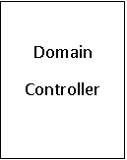

WEF to Logstash using NXlog
listening on tcp port 3515
Event Forwarding Using WinRm

Slide 9
How do we do it?
Configuring a group Policy on the Domain Controller to enable WinRm, firewall rules and Event Forwarding.
Create a subscription on the event forwarding server for the domain.
Start NXlog as a service on Event forwarder to send logs to ELK server on tcp port 3515.
Configuring logstash on ELK Server to listen on 3515 and push incoming logs into elasticsearch using the provided configuration file.

Slide 10
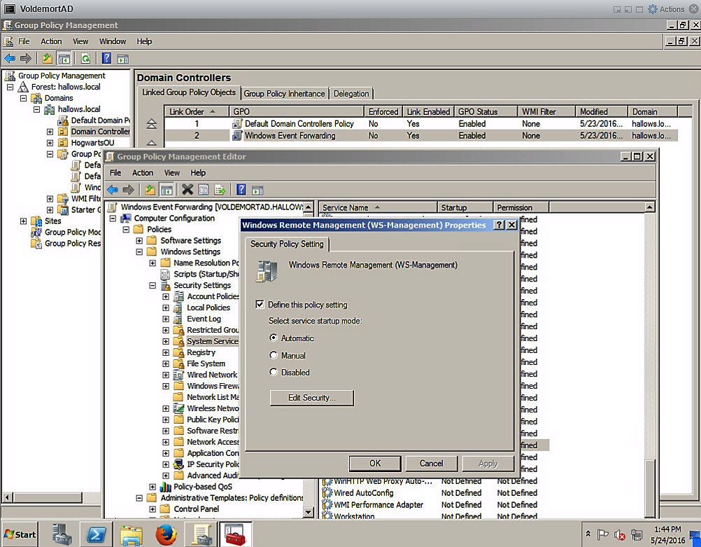
Group Policy on Domain Controller

Slide 11
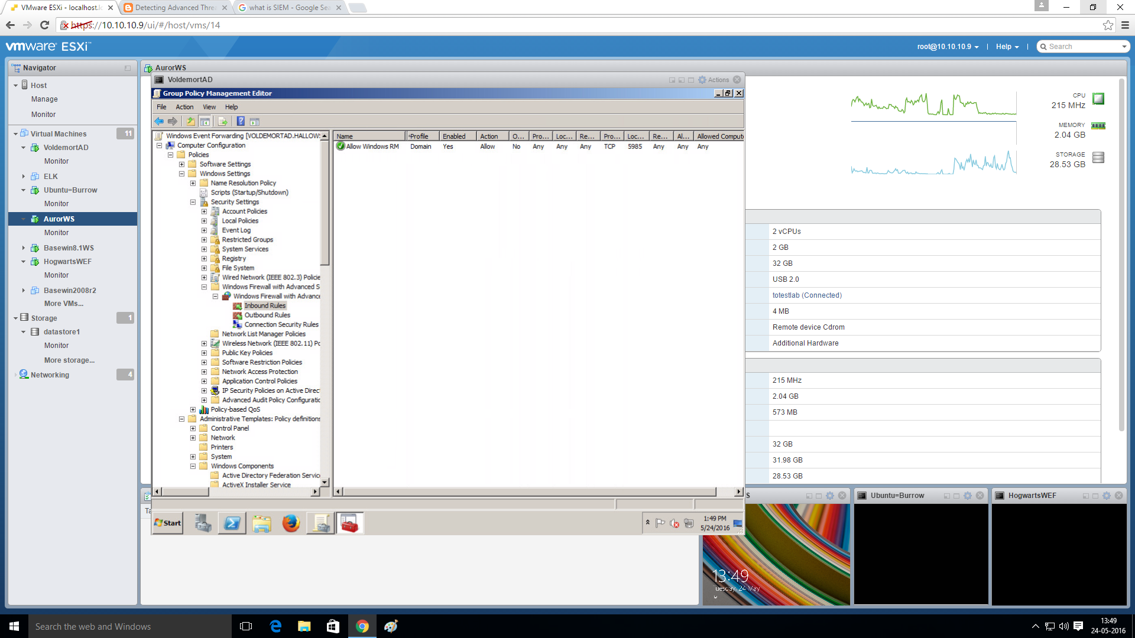
Allow inbound TCP traffic

Slide 12
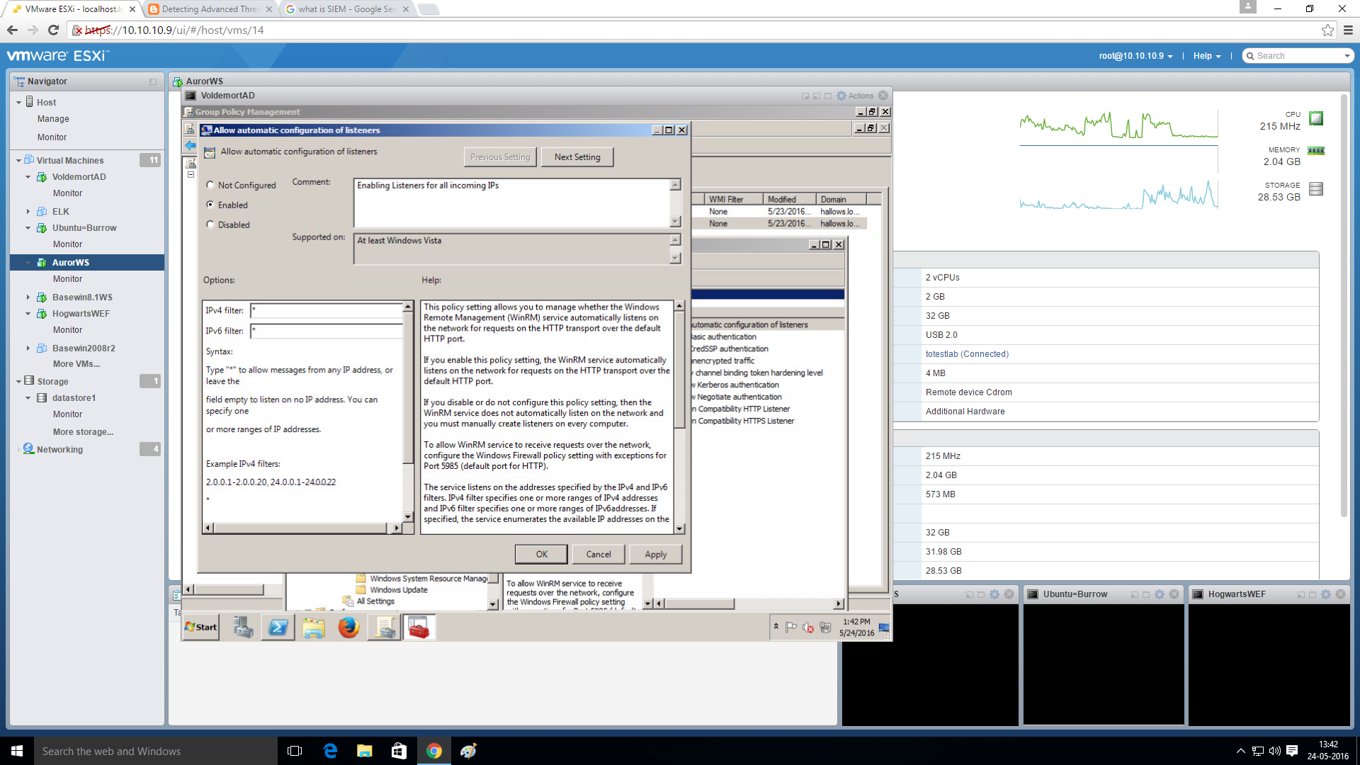
Allow Listeners on Domain Controller

Slide 13
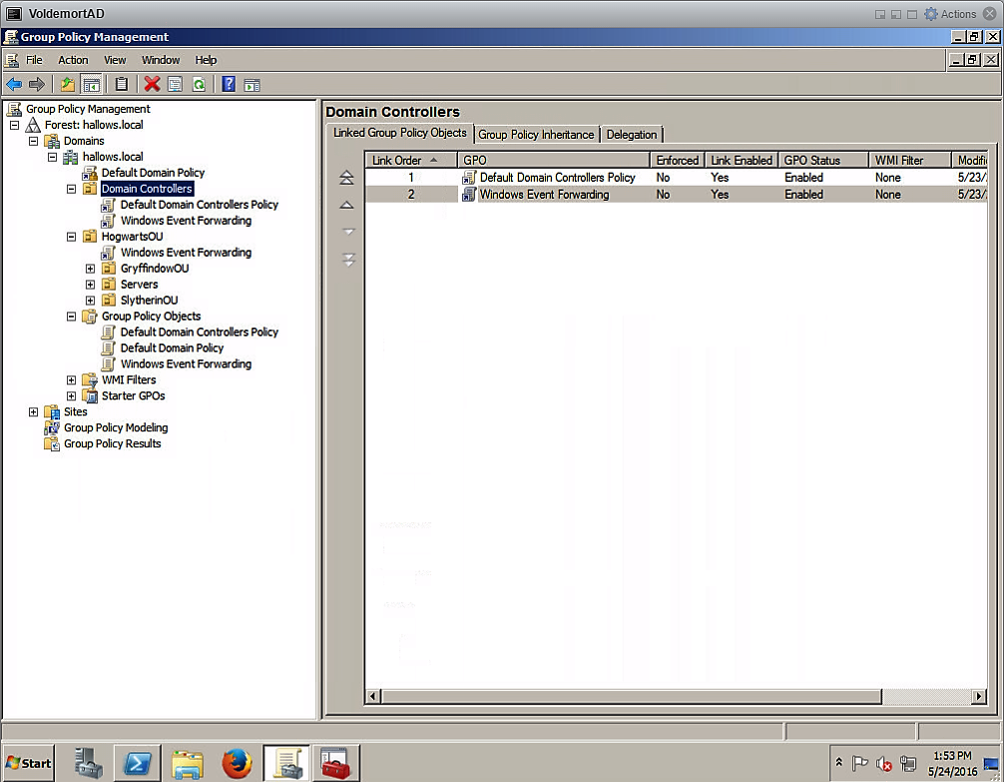
Link WEF Policy

Slide 14
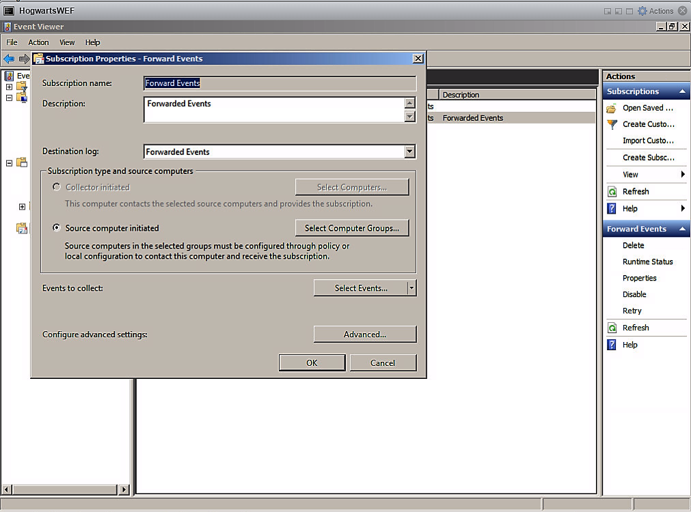
Creating Subscription on WEF server

Slide 15
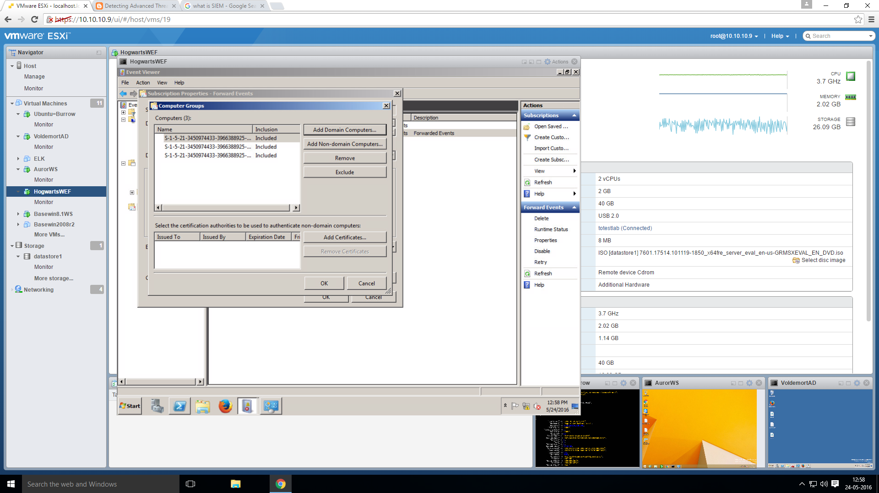

Slide 16
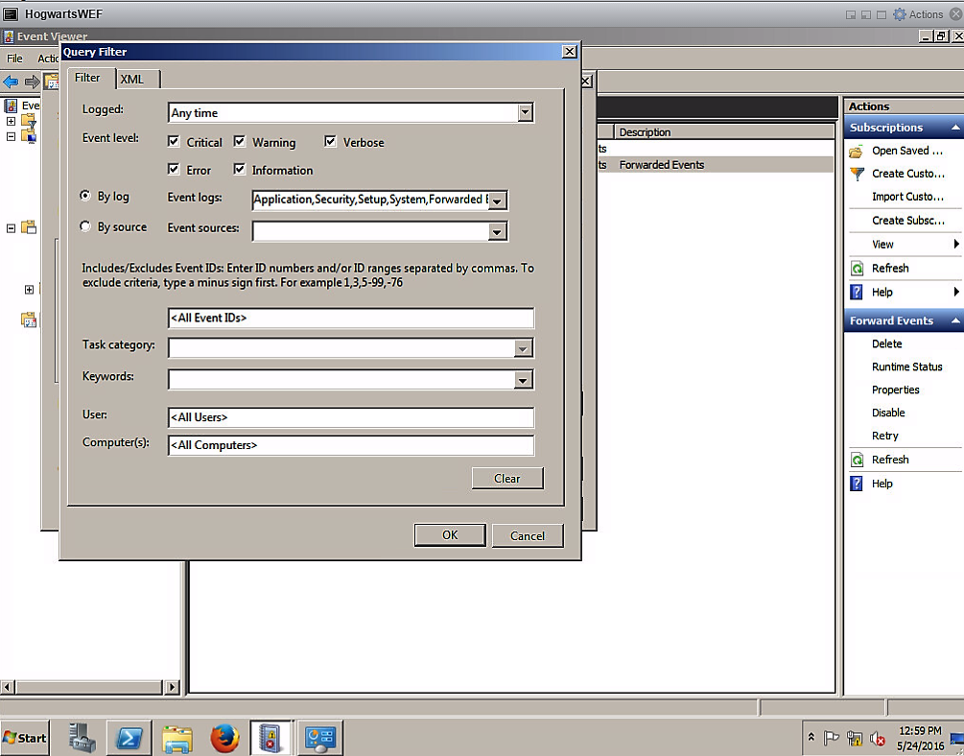

Slide 17
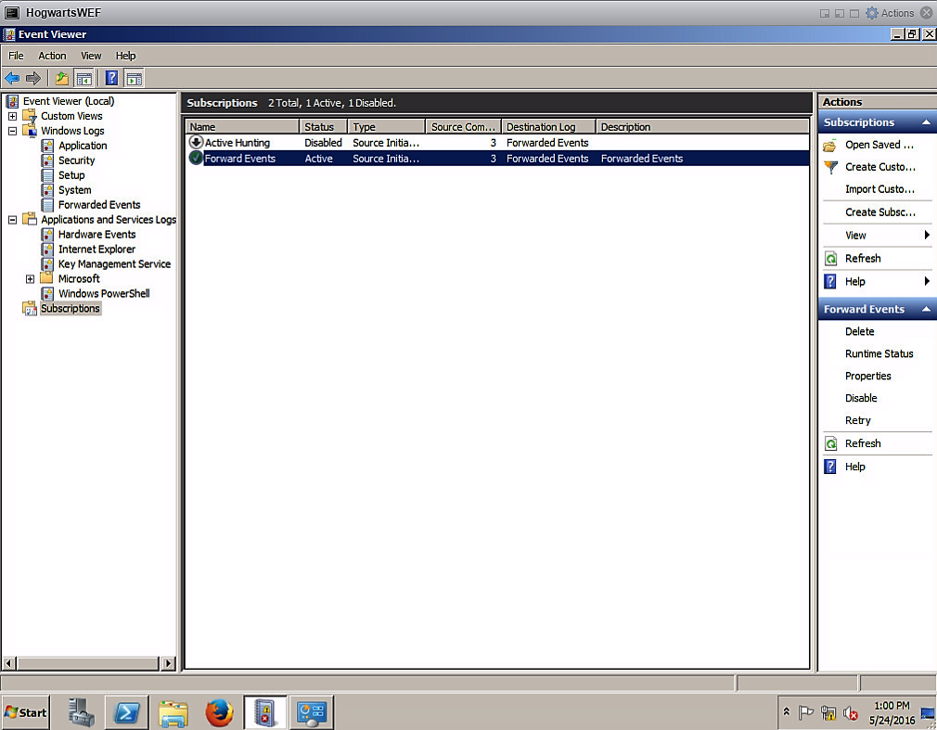

Slide 18
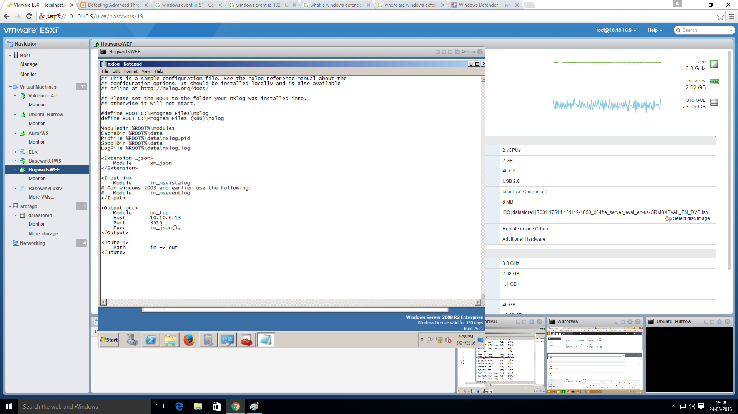
Nxlog configuration file

Slide 19
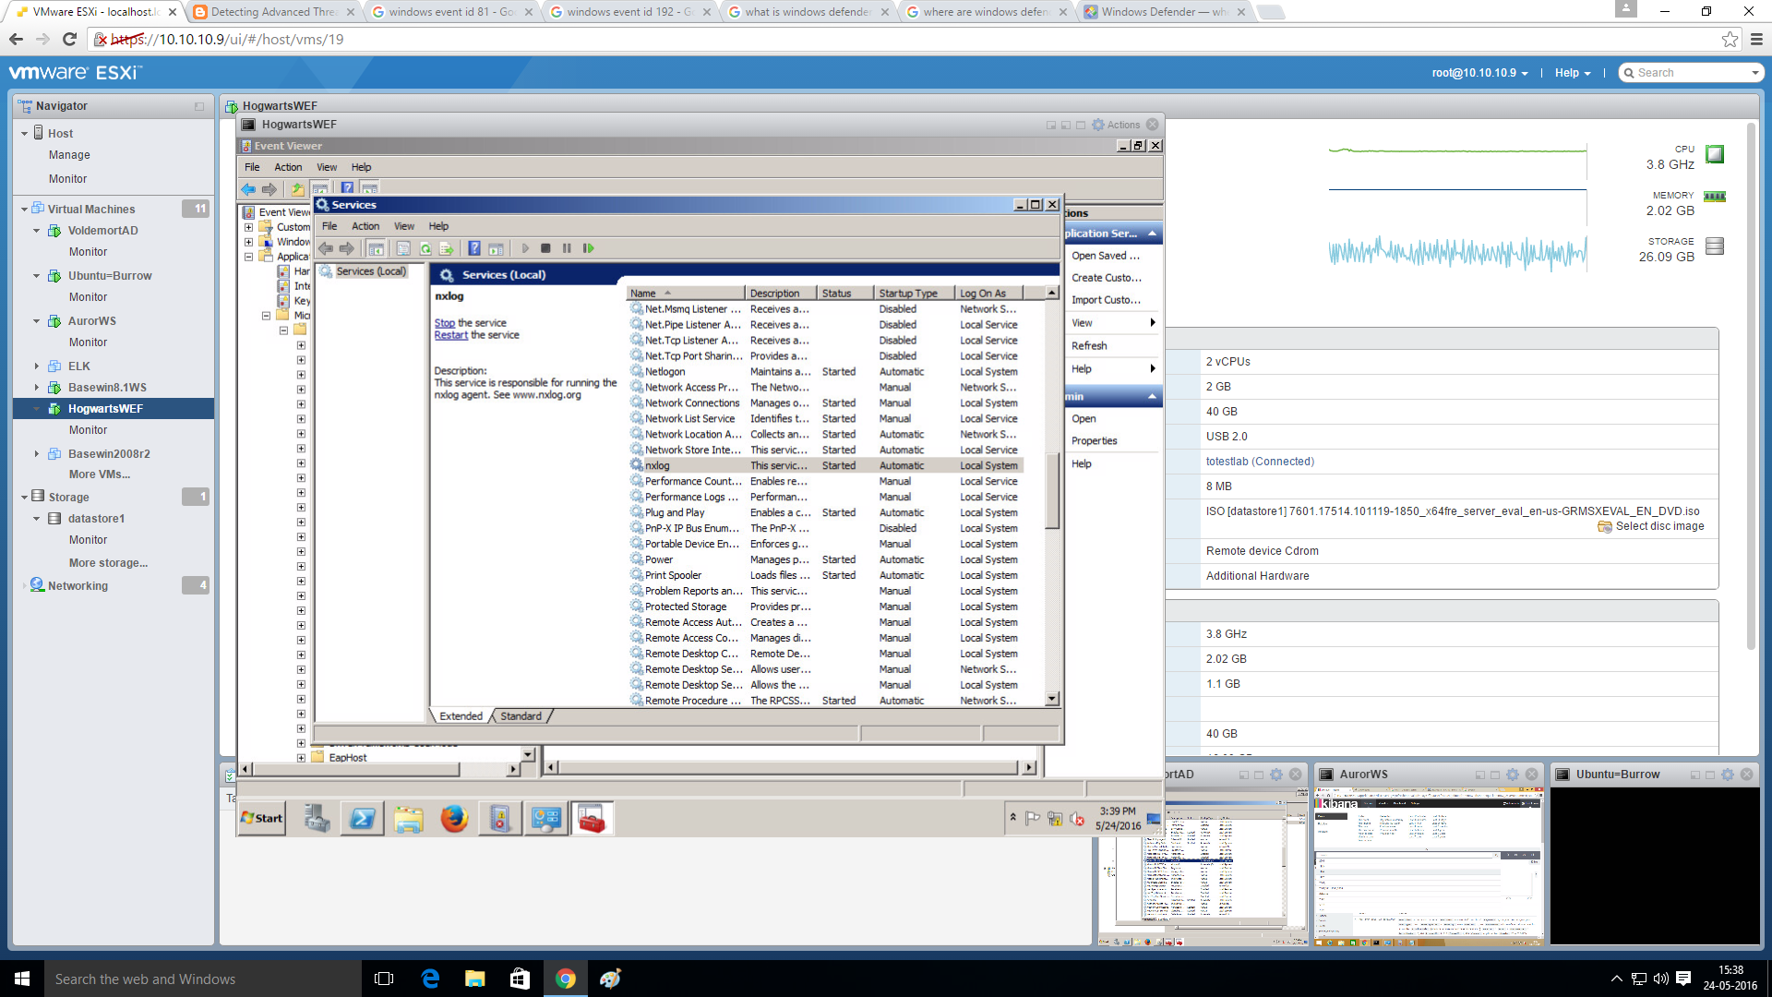
Nxlog service Enabled

Slide 20
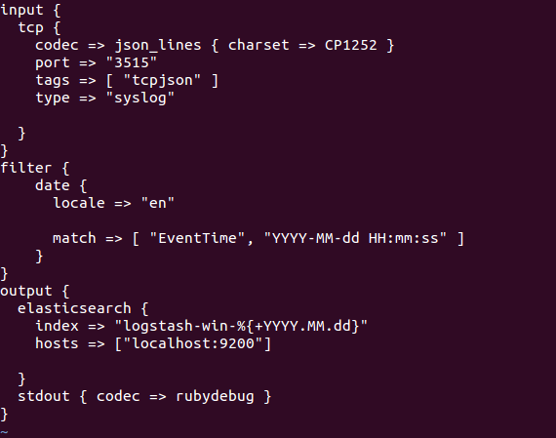
Logstash Configuration

Slide 21
Hacking Simulation
Windows Powershell(PS) is a legitimate tool in Windows.
It is seldom used to carry out internal lateral movement and PS scripts are used to attack the system as they do not raise a red flag.
This is PS attack to obtain the credentials of a system by dumping AD logs and goes undetected by the system.
We track this Powershell activity as it anamalous for domain computers.
Mimikatz is the tool used for this purpose.

Slide 22
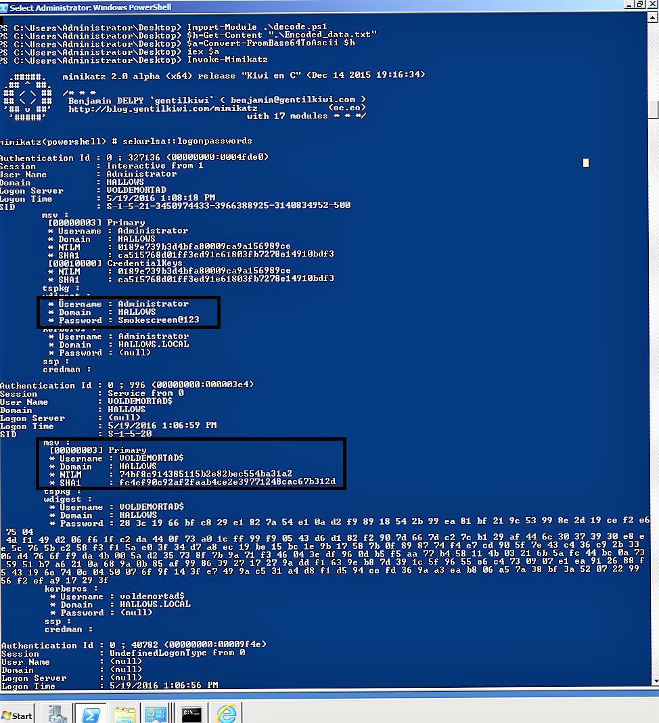
Powershell: Mimikatz

Slide 23
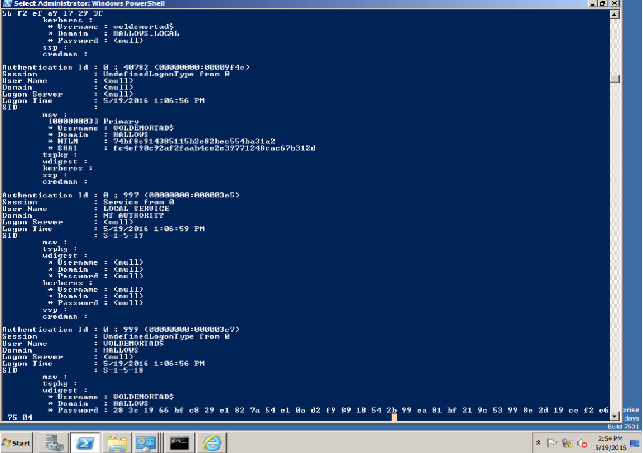

Slide 24
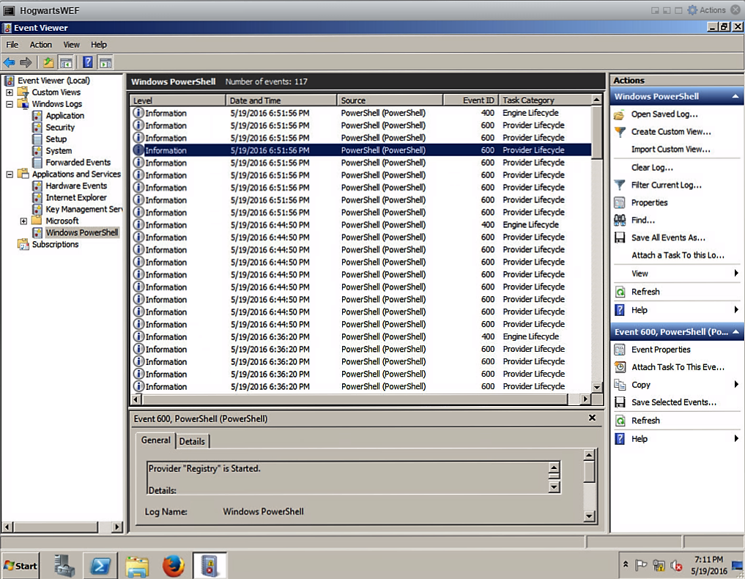
PS Activity On Event Viewer

Slide 25
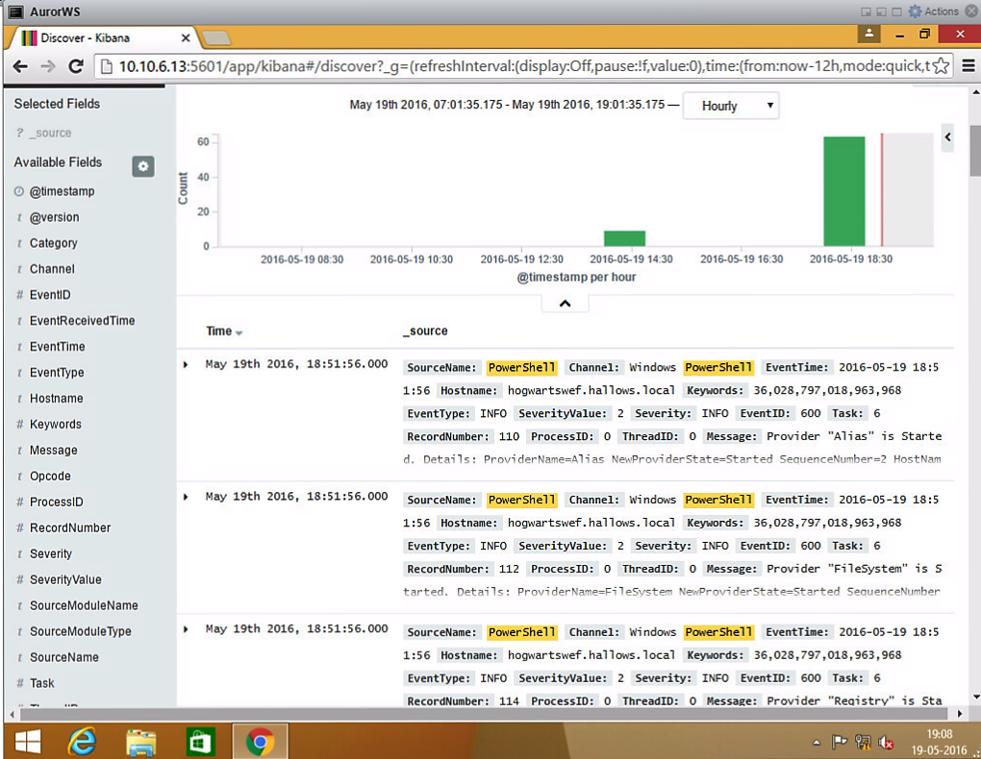
PS Tracked on Kibana

Slide 26
Conclusions
ELK stack is an open source ,neatly compiled and state of the art tool for data logging and analytics.
Corporations are deploying it as it saves them millions of dollars.
It is not complicated as grep or RegEx.
Kibana is a text ,not script based search dashboard which allows ease of use.

Slide 27
THANK YOU

